Slide 1
The Rise of the Machines
by Peter DeMartini
Your feedback is important to us
Please text @T63 to 39242
Thank you!

Slide 2
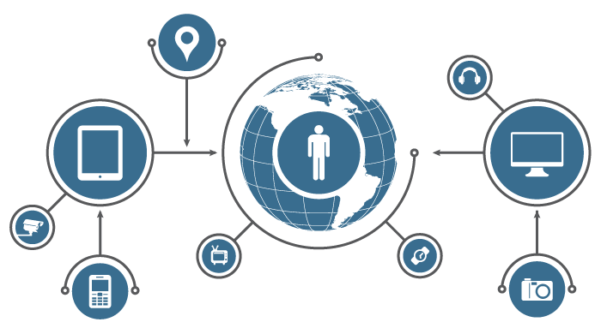
What is the
Internet of Things?

Slide 3
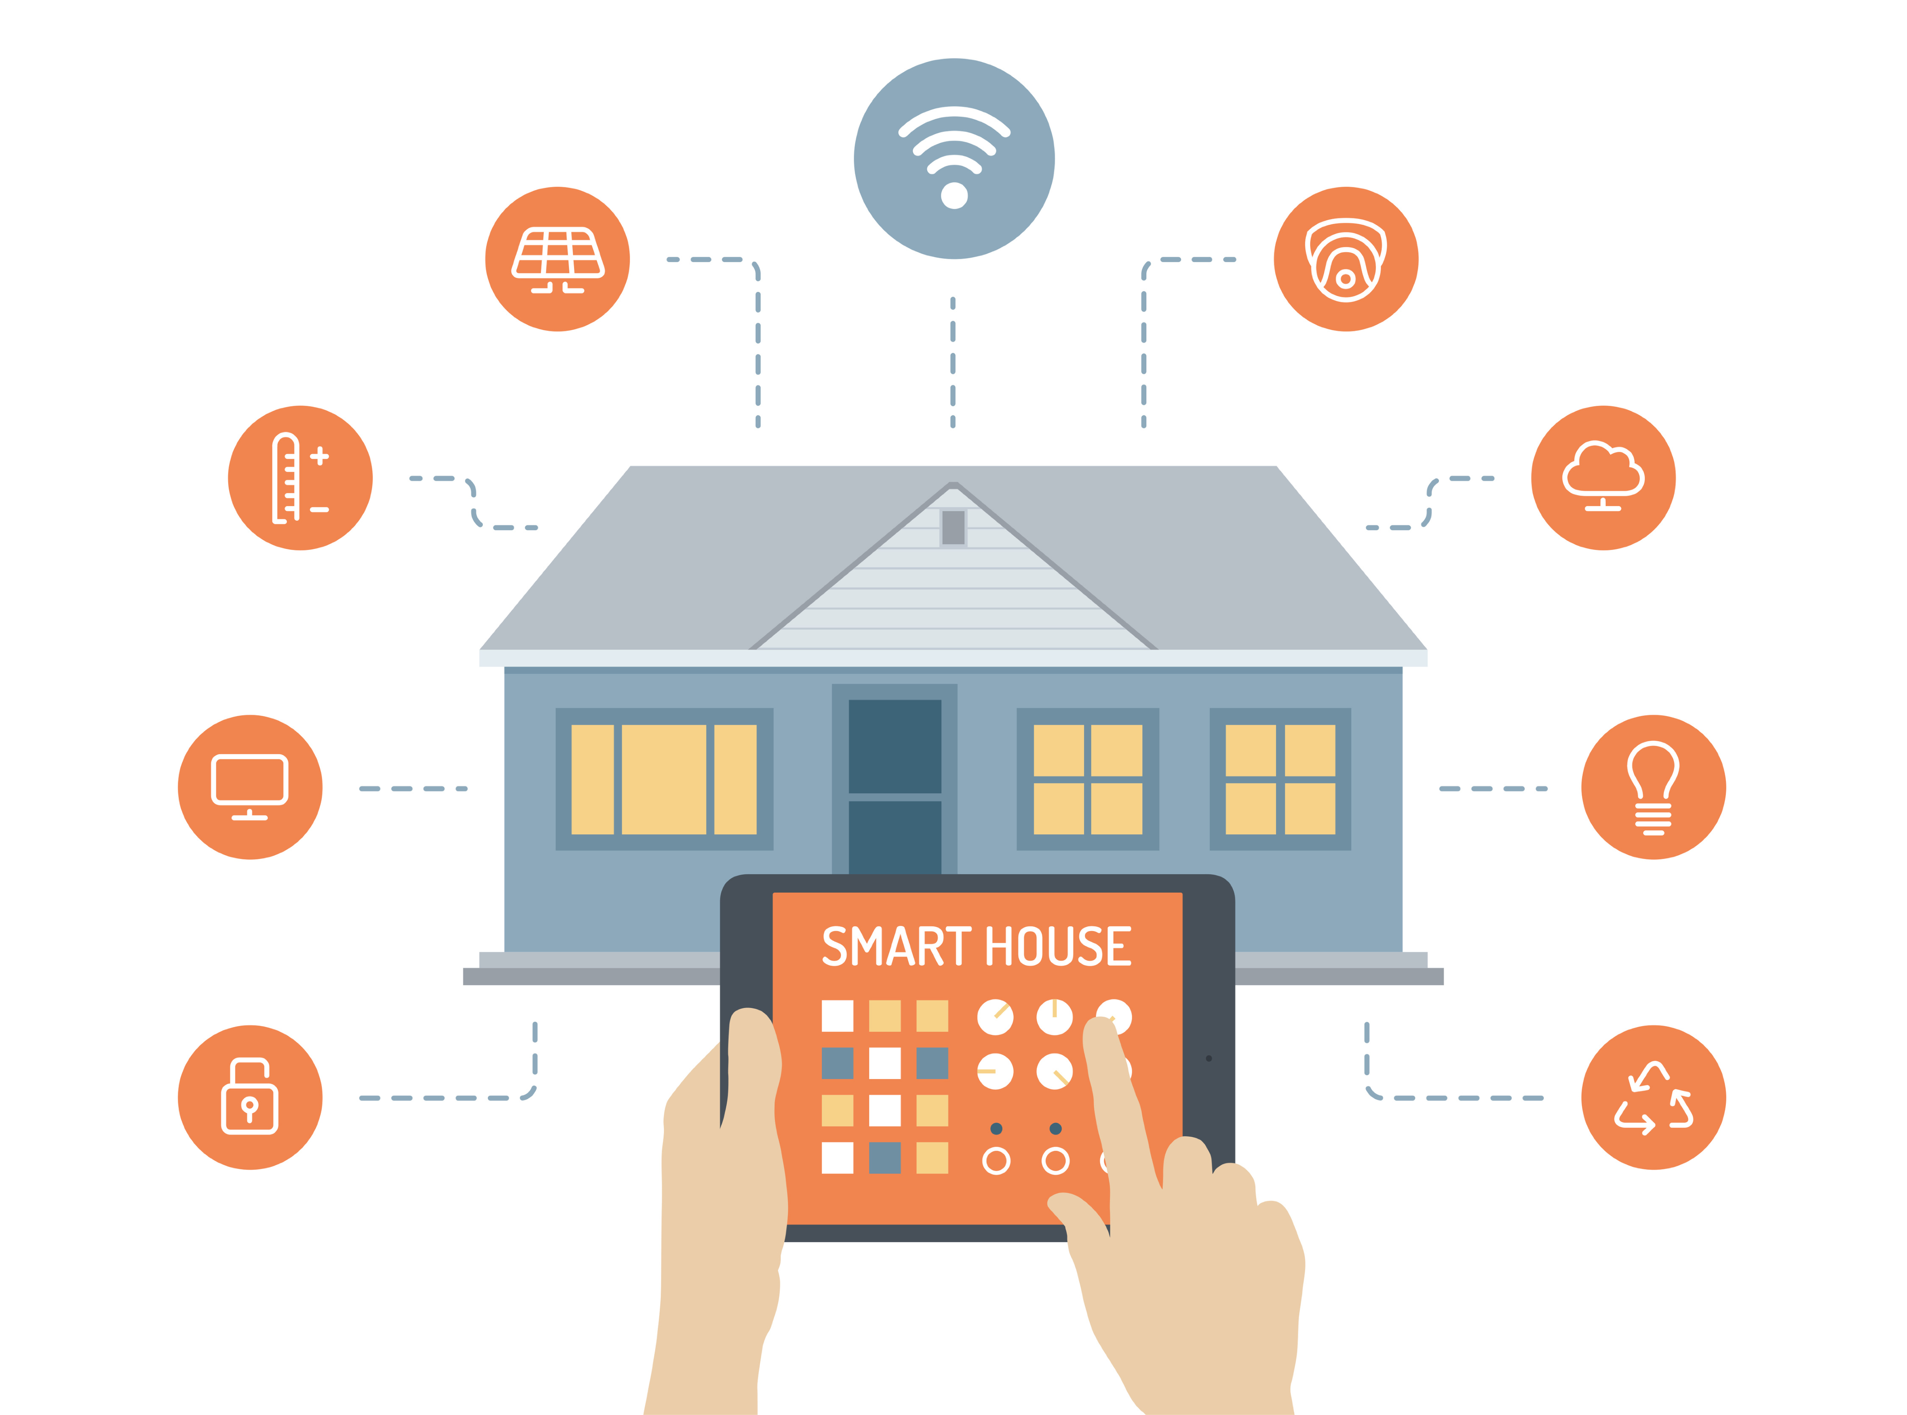
Smart Devices, Connected to Everything

Slide 4
“The Internet of Things has the potential to change the world, just as the internet did. Maybe even more so.”
~ Kevin Ashton

Slide 5
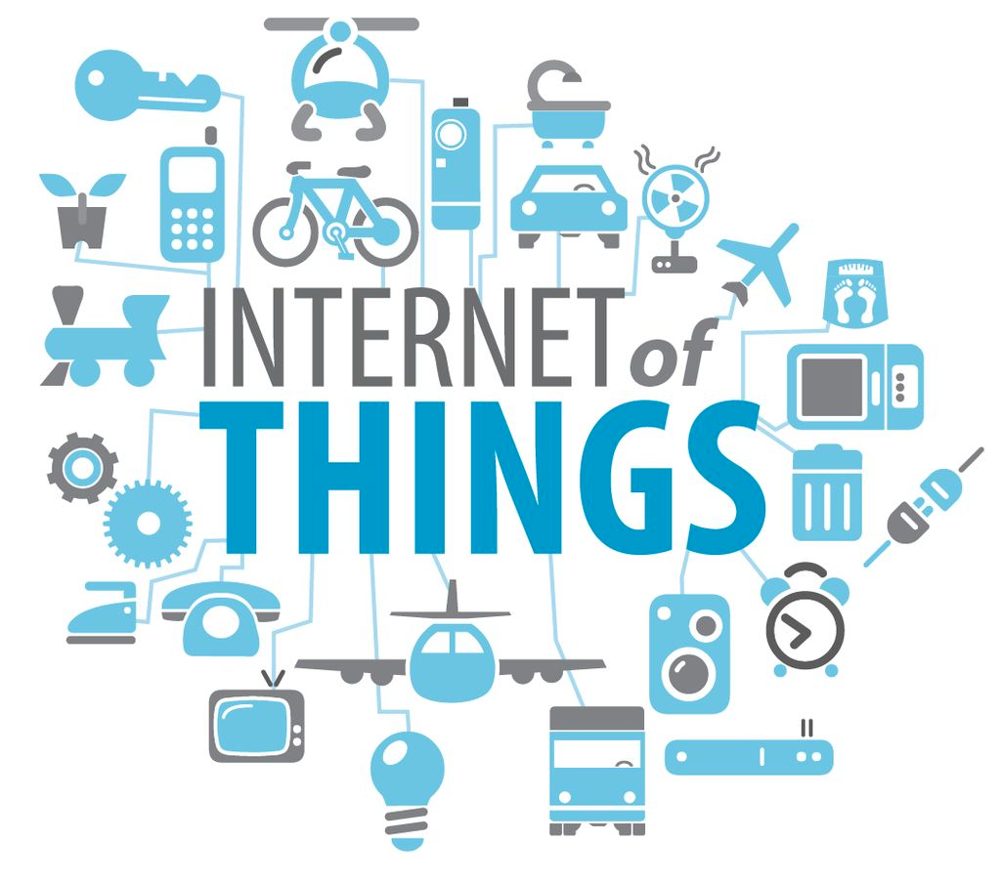
- Device Intelligence
- Automation
- Growth

Slide 6
Today: 1.9B connected devices. 50B estimated by 2020.

Slide 7
By 2020, the IoT market value is predicted to be between $3T and $14T

Slide 8
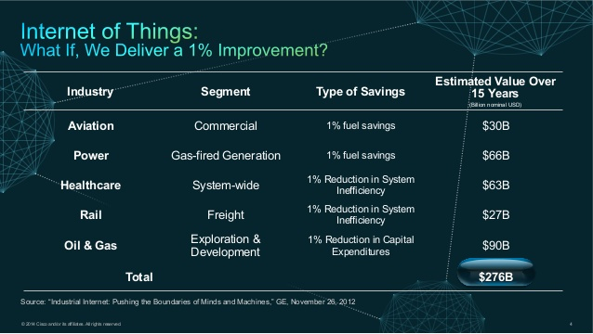

Slide 9
IoT & Business Automation

Slide 10
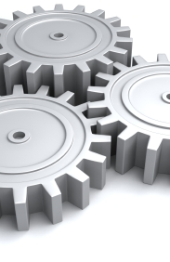
Automation
Let machines do the hard work

Slide 11
“Everything that can be automated, will be automated.”
~ Robert Cannon

Slide 12
Machine Learning
Anomaly detection
Event prediction
Context aware systems

Slide 13
Human Interaction
Humans have the power of personality and creativity, automate the rest.

Slide 14
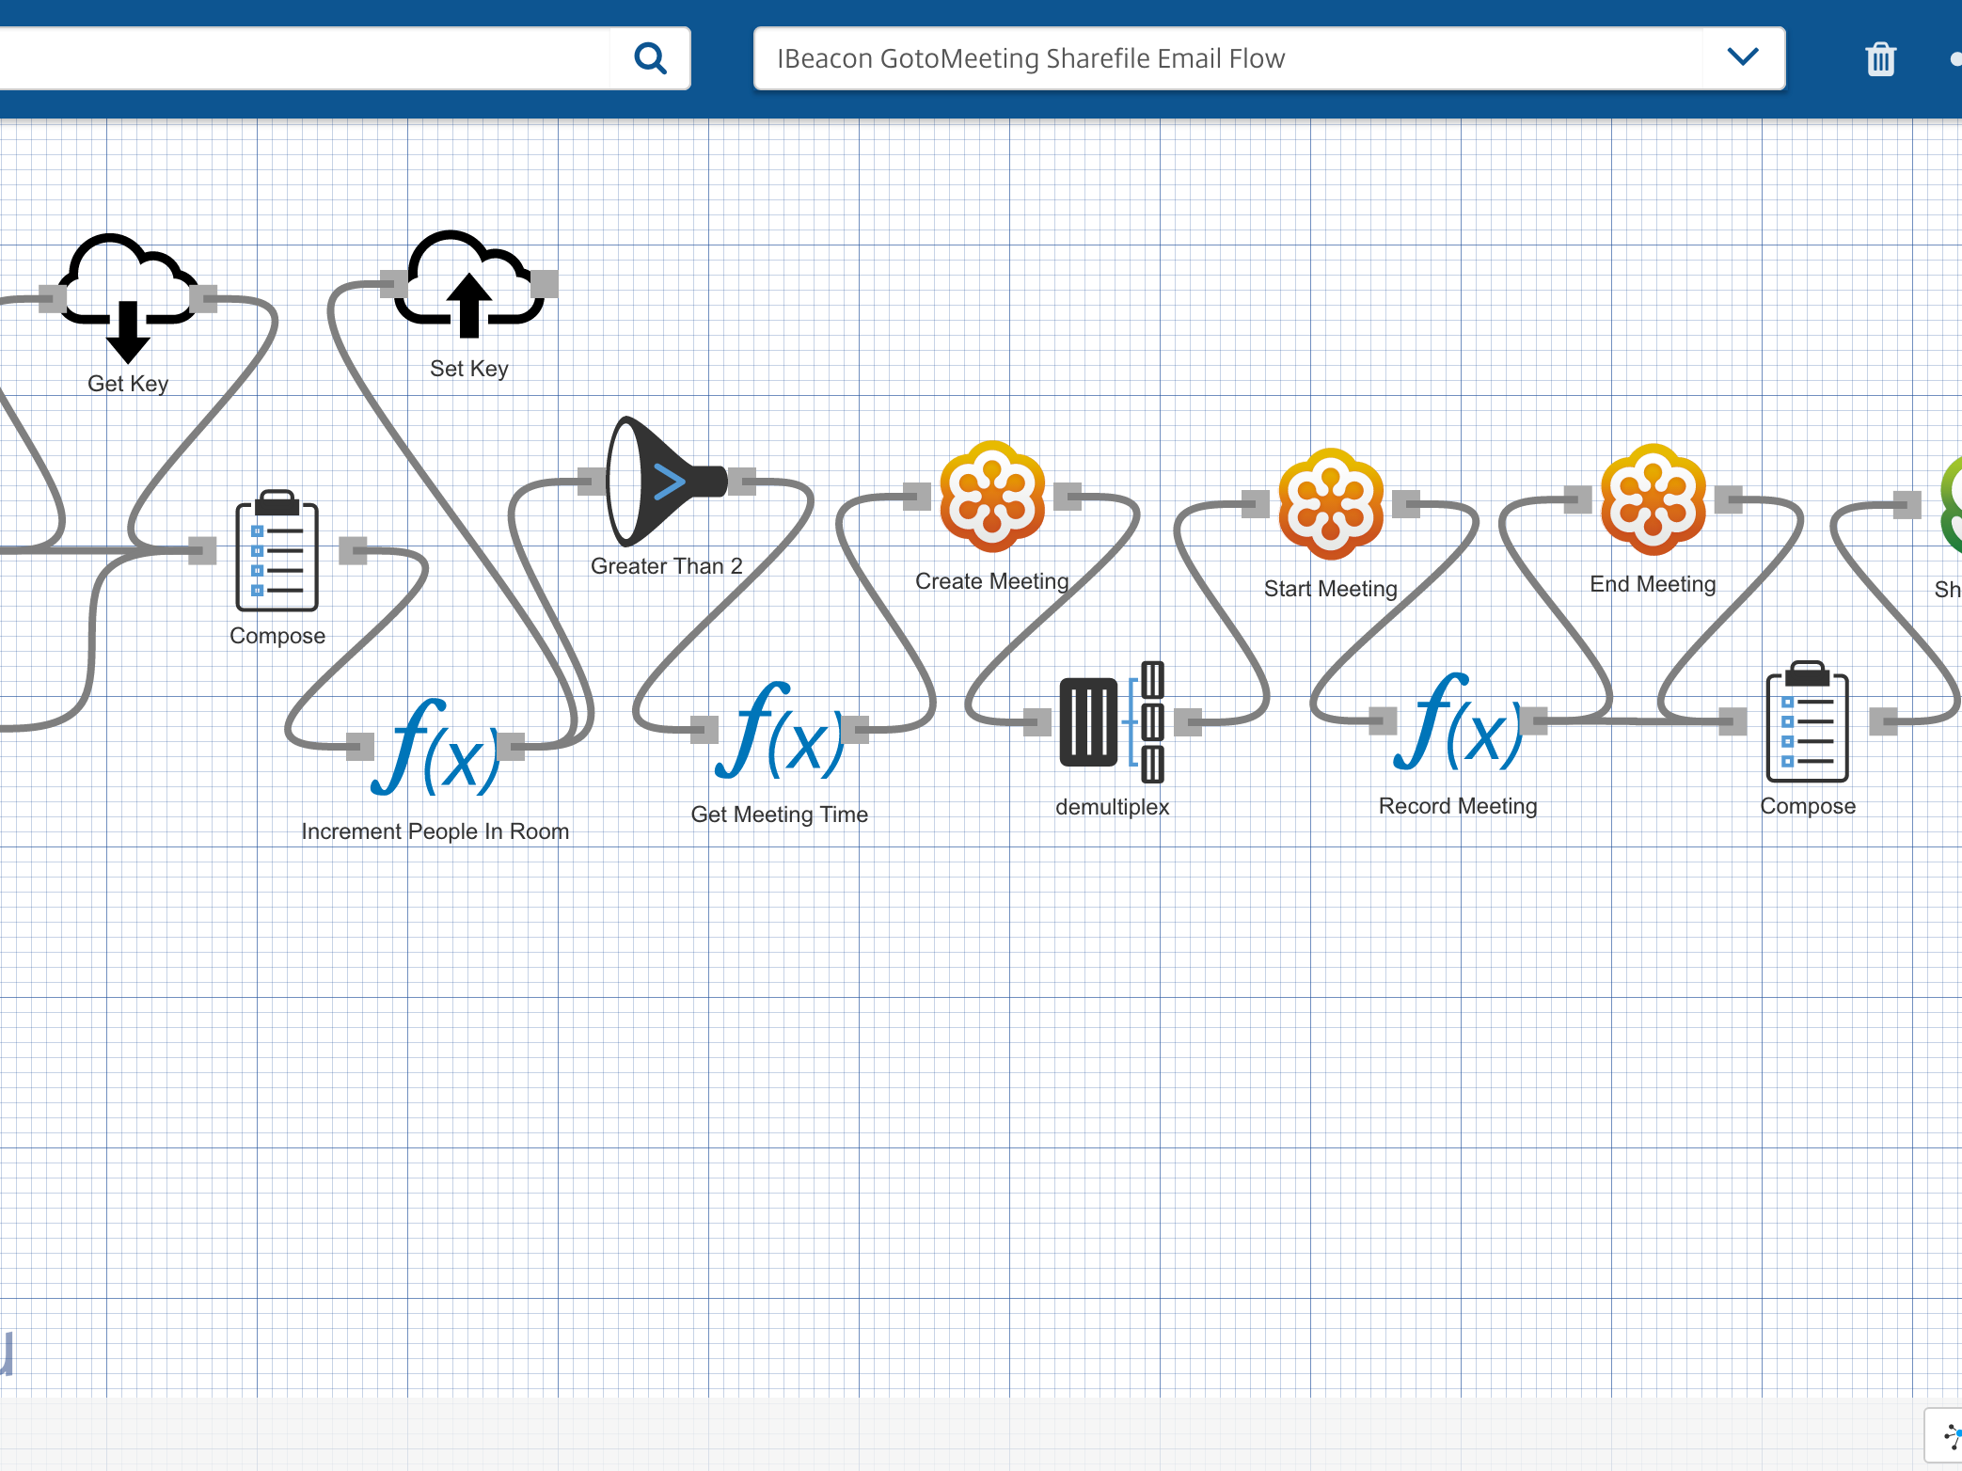

Octoblu
The Internet of Things operating system

Slide 15
Connect, Design, Compute, and Analyze

Slide 16
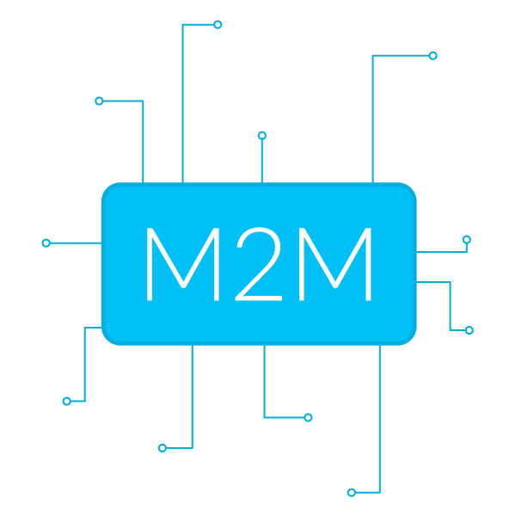
Talking to devices is hard, we make it easy

Slide 17
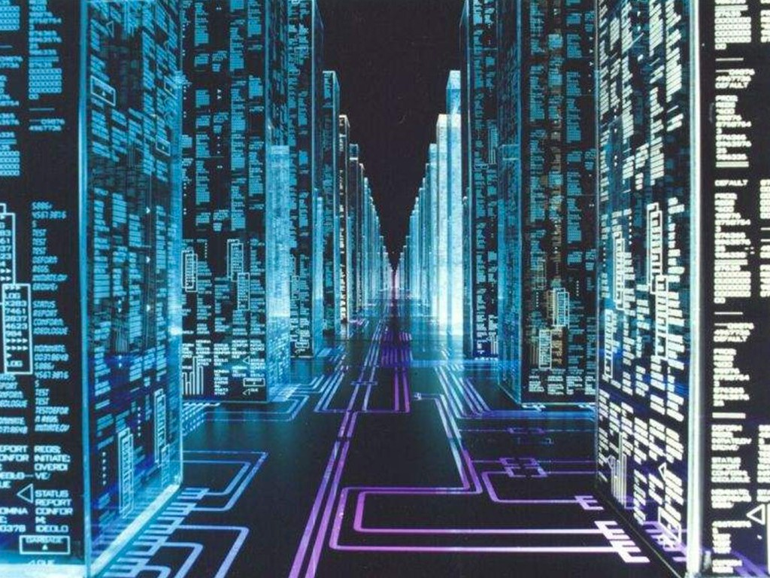
Make it easy for machines to talk to machines

Slide 18
With the rise of machines how do humans communicate?

Slide 19


Slide 20
A collection of services designed to engage human interactions.

Slide 21
Impact
Save man hours
Security
The power of IoT
Smart devices, smart people

Slide 22
Lessons Learned

Slide 23
Be Lazy

Slide 24
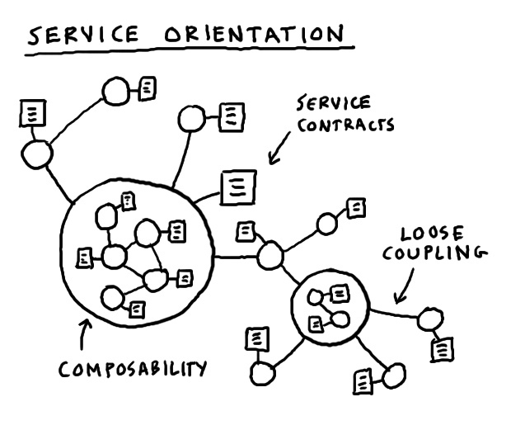
Microservices
Complex applications written in small independent programs

Slide 25
Machines cost far less than humans

Slide 26
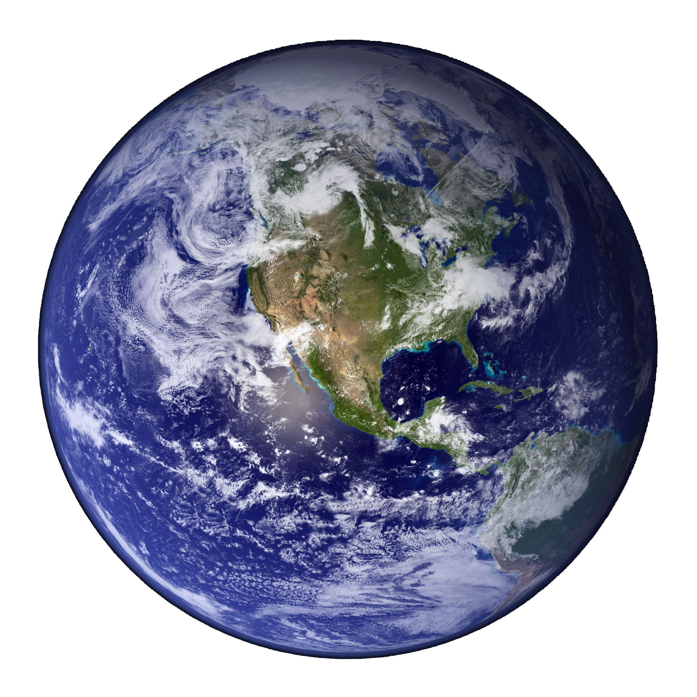
Make the world a better place

Slide 27

Let humans do what they do best

Slide 28
Your feedback is important to us
Please text @T63 to 39242
Thank you!
Peter DeMartini
Twitter: @PeterDeMartini
Email: p@octoblu.com
Slide Deck available at
https://github.com/peterdemartini/rise-of-the-machines-talk/

